Slide 1
Genome Browser 3 Querying the Tables
HUGEN 2073
Genomic Data Visualization & Integration
Slides adapted from Ryan L. Minster, PhD, MSIS

Slide 2
Learning Objectives
By the end of the session, students will be able to:
Query tables in a relational database using SQL SELECT statements
Query tables in the UCSC Genome Browser using SQL statements in R
Extract data from BigBed files in the UCSC Genome Browser

Slide 3
Tables
Location and name of variants with entries in the GWAS Catalog that are within 5 kbp of ABO TSS and TES, the trait(s) examined in the study, the p value of the association(s), and whether the variant is a copy number variant or not.
Database
Table
Region
Fields

Slide 4
Tables
Location and name of variants with entries among the GTEx eQTLs that are within 20 kbp of TP53 TSS and 1 kbp of TP53 TES*, the gene symbol and tissue examined in the study, the p value of the association.
Database
Table
Region
Fields
* Veyrieras et al. PLoS Genet 2008

Slide 5
Common Database Systems
​Flat-file: simple text files containing information in records (rows), delimited by a specific character—creating fields (columns)
Excel
Text files (.txt or .csv files)
​Relational databases: data is broken down into separate tables, each with its own set of records and fields, where the relationship between tables is given by a schema and a set of common keys
​Primary keys are columns where each value is unique in that particular table
​Foreign keys are columns in a table that are a primary key in another table.

Slide 6
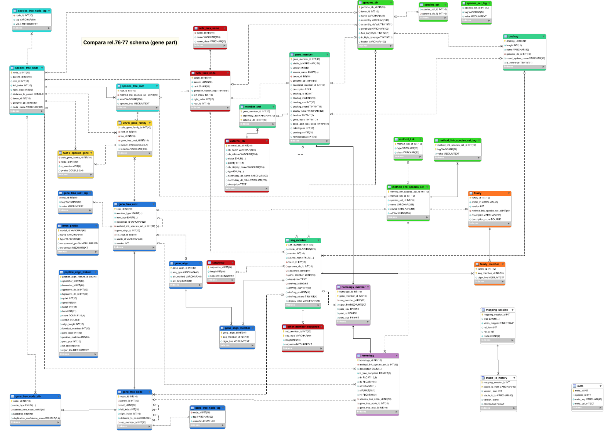
Example of Relational Schema
uswest.ensembl.org/info/docs/api/compara/compara_schema.html

Slide 7
Example Relational Database
snp chrom chromStart chromEnd name
primary key foreign key
chr chrom length

Slide 8
Example Data
snp chrom chromStart chromEnd name -------------------------------------- chr1 166167081 166167082 rs919033151 chr2 3000008 3000009 rs922451827 chr3 23489803 23489804 rs114587031 chr3 23489842 23489843 rs899924466 chrX 1456756 1456757 rs7055080
chr chrom length --------------- chr1 248956422 chr2 242193529 chr3 198295559 chr4 190214555 chr5 181538259 chrX 156040895

Slide 9
SQL
Pronounced: S-Q-L /ˌɛsˌkjuːˈɛl/ or sequel /ˈsiːkwəl/
​Structured Query Language
Designed for relational database management systems
SQL statements allow for data queries and data manipulation

Slide 10
SQL Queries
An SQL query is built around what is called a SELECT statement.
A SELECT statement allows you to extract (select!) data from a table, choosing particular fields and particular rows sorted into a particular order.

Slide 11
SELECT Statement
SELECT column FROM table WHERE row_condition ORDER BY column;
For example:
SELECT chrom FROM chr WHERE length > 20000000;

Slide 12
SELECT Statement
For example:
SELECT chrom FROM chr WHERE length > 200000000;
Output:
chrom ----- chr1 chr2
chr chrom length --------------- chr1 248956422 chr2 242193529 chr3 198295559 chr4 190214555 chr5 181538259 chrX 156040895

Slide 13
SELECT Statement
chr chrom length --------------- chr1 248956422 chr2 242193529 chr3 198295559 chr4 190214555 chr5 181538259 chrX 156040895
For example:
SELECT chrom FROM chr WHERE length > 20000000;
Equivalent to R statement:
chr[chr$length > 20000000, c("chrom")] or chr$chrom[chr$length > 20000000] or chr %>% filter(length > 20000000) %>% select(chrom)

Slide 14
SELECT Statement multiple fields
SELECT column1, column2, column3, etc. FROM table WHERE row_condition ORDER BY column;
For example:
SELECT chrom, chromEnd, name FROM snp WHERE chromEnd > 20000000;
snp chrom chromStart chromEnd name -------------------------------------- chr1 166167081 166167082 rs919033151 chr2 3000008 3000009 rs922451827 chr3 23489803 23489804 rs114587031 chr3 23489842 23489843 rs899924466 chrX 1456756 1456757 rs7055080
I switched tables! FYI

Slide 15
SELECT Statement multiple fields
For example:
SELECT chrom, chromEnd, name FROM snp WHERE chromEnd > 20000000;
Output:
chrom chromEnd name chr1 166167082 rs919033151 chr3 23489804 rs114587031 chr3 23489843 rs899924466
snp chrom chromStart chromEnd name -------------------------------------- chr1 166167081 166167082 rs919033151 chr2 3000008 3000009 rs922451827 chr3 23489803 23489804 rs114587031 chr3 23489842 23489843 rs899924466 chrX 1456756 1456757 rs7055080

Slide 16
SELECT Statement all fields
For example:
SELECT * FROM snp WHERE chromEnd > 20000000;
Output:
chrom chromStart chromEnd name chr1 166167081 166167082 rs919033151 chr3 23489803 23489804 rs114587031 chr3 23489842 23489843 rs899924466
snp chrom chromStart chromEnd name -------------------------------------- chr1 166167081 166167082 rs919033151 chr2 3000008 3000009 rs922451827 chr3 23489803 23489804 rs114587031 chr3 23489842 23489843 rs899924466 chrX 1456756 1456757 rs7055080

Slide 17
SELECT Statement multiple row conditions
SELECT column1 FROM table WHERE row_condition1 OPERATOR row_condition2 OPERATOR etc. ORDER BY column;
For example:
SELECT chrom, chromEnd, name FROM snp WHERE chromEnd > 20000000 AND chromEnd < 100000000;

Slide 18
SELECT Statement multiple row conditions
For example:
SELECT chrom, chromEnd, name FROM snp WHERE chromEnd > 20000000 AND chromEnd < 100000000;
Output:
chrom chromEnd name chr3 23489804 rs114587031 chr3 23489843 rs899924466
snp chrom chromStart chromEnd name -------------------------------------- chr1 166167081 166167082 rs919033151 chr2 3000008 3000009 rs922451827 chr3 23489803 23489804 rs114587031 chr3 23489842 23489843 rs899924466 chrX 1456756 1456757 rs7055080

Slide 19
Row Logical Operators
AND logical and name = 'rs101' AND chrom = 'chrY'
OR logical or name = 'rs101' OR name = 'rs102'
NOT logical not chromEnd > 1000 AND NOT chrom = 'chr22'
Parenthesis (()) can be used for grouping to applied an operation order, which is otherwise left to right.

Slide 20
Row Conditional Operators
= equal to name = 'rs101'
<> not equal to name <> 'rs101'
> greater than chromEnd > 1000
< less than chromEnd < 1000
>= equal to chromEnd >= 1000
<= equal to chromEnd <= 1000

Slide 21
Row Conditional Operators
[NOT] BETWEEN [SYMMETRIC]
inclusive range · chromEnd BETWEEN 1000 AND 2000
inclusive range · chromEnd BETWEEN SYMMETRIC 2000 AND 1000 SYMMETRIC allows A and B to be reversed by the SQL parser if A > B
[NOT] LIKE
wildcard matching · name LIKE 'rs10%’
wildcard matching · name NOT LIKE 'rs10__' LIKE has two wildcard operators: % and _, equivalent to regex * and .

Slide 22
Row Conditional Operators
[NOT] IN present in set name IN ('rs101', 'rs102')
IS [NOT] NULL is missing name IS NULL
IS [NOT] TRUE / FALSE true or false name IS FALSE

Slide 23
SELECT Statement if no WHERE condition
For example:
SELECT chrom, chromStart, chromEnd, name FROM snp;
Output:
chrom chromStart chromEnd name chr1 166167081 166167082 rs919033151 chr2 3000008 3000009 rs922451827 chr3 23489803 23489804 rs114587031 chr3 23489842 23489843 rs899924466 chrX 1456756 1456757 rs7055080
snp chrom chromStart chromEnd name -------------------------------------- chr1 166167081 166167082 rs919033151 chr2 3000008 3000009 rs922451827 chr3 23489803 23489804 rs114587031 chr3 23489842 23489843 rs899924466 chrX 1456756 1456757 rs7055080
All rows returned.

Slide 24
SELECT Statement ORDER BY
For example:
SELECT chrom, chromEnd, name FROM snp WHERE chromEnd > 20000000 AND chromEnd < 100000000 ORDER BY chrom, chromEnd DESC;
Output:
chrom chromEnd name chr3 23489843 rs899924466 chr3 23489804 rs114587031
snp chrom chromStart chromEnd name -------------------------------------- chr1 166167081 166167082 rs919033151 chr2 3000008 3000009 rs922451827 chr3 23489803 23489804 rs114587031 chr3 23489842 23489843 rs899924466 chrX 1456756 1456757 rs7055080

Slide 25
SELECT Statement ORDER BY
For example:
SELECT chrom, chromEnd, name FROM snp WHERE chromEnd > 20000000 AND chromEnd < 100000000 ORDER BY chrom, chromEnd [ASC];
Output:
chrom chromEnd name chr3 23489804 rs114587031 chr3 23489843 rs899924466
snp chrom chromStart chromEnd name -------------------------------------- chr1 166167081 166167082 rs919033151 chr2 3000008 3000009 rs922451827 chr3 23489803 23489804 rs114587031 chr3 23489842 23489843 rs899924466 chrX 1456756 1456757 rs7055080

Slide 26
SELECT Statement Joining tables
For example:
SELECT snp.chrom, snp.name, chr.length FROM snp JOIN chr ON snp.chrom = chr.chrom WHERE snp.chromEnd > 20000000 AND snp.chromEnd < 100000000 ORDER BY snp.chrom, snp.chromEnd;
Output:
snp.chrom chr.length snp.name chr3 198295559 rs114587031 chr3 198295559 rs899924466
snp chrom chromStart chromEnd name -------------------------------------- chr1 166167081 166167082 rs919033151 chr2 3000008 3000009 rs922451827 chr3 23489803 23489804 rs114587031 chr3 23489842 23489843 rs899924466 chrX 1456756 1456757 rs7055080
chr chrom length --------------- chr1 248956422 chr2 242193529 chr3 198295559 chr4 190214555 chr5 181538259 chrX 156040895

Slide 27
JOIN Types
[INNER] JOIN Returns only records that have matching values in both tables
LEFT [OUTER] JOIN Returns all records from left table, and only matching records from the right table
RIGHT [OUTER] JOIN Returns all records from right table, and only matching records from the left table
FULL [OUTER] JOIN Returns all records from both tables

Slide 28
JOIN Types Examples
a id name 1 John 2 María
b id month year 1 March 1965 3 May 1964
SELECT a.id, a.name, b.month, b.year FROM a JOIN b ON a.id = b.id;
a.id a.name b.month b.year 1 John March 1965

Slide 29
JOIN Types Examples
a id name 1 John 2 María
b id month year 1 March 1965 3 May 1964
SELECT a.id, a.name, b.month, b.year FROM a LEFT JOIN b ON a.id = b.id;
a.id a.name b.month b.year 1 John March 1965 2 María NULL NULL

Slide 30
JOIN Types Examples
a id name 1 John 2 María
b id month year 1 March 1965 3 May 1964
SELECT a.id, a.name, b.month, b.year FROM a RIGHT JOIN b ON a.id = b.id;
a.id a.name b.month b.year 1 John March 1965 3 NULL May 1964

Slide 31
JOIN Types Examples
a id name 1 John 2 María
b id month year 1 March 1965 3 May 1964
SELECT a.id, a.name, b.month, b.year FROM a JOIN b ON a.id = b.id;
a.id a.name b.month b.year 1 John March 1965 2 María NULL NULL 3 NULL May 1964

Slide 32
Example Query from Table Browser
SELECT chrom, chromStart, chromEnd, name, refNCBI FROM hg38.snp151 WHERE chrom = 'chr17' AND chromStart >= 7571720 AND chromEnd <= 7590868 ORDER BY chrom, chromStart;

Slide 33
Output
chrom chromStart chromEnd name refNCBI
1 chr17 7571723 7571724 rs139336280 C 2 chr17 7571725 7571726 rs1443355678 G 3 chr17 7571728 7571729 rs892233376 G 4 chr17 7571735 7571736 rs1429990273 T 5 chr17 7571737 7571738 rs1320917854 G 6 chr17 7571741 7571742 rs570627179 A . . .

Slide 34
Example JOIN Query from Table Browser
SELECT hg38.snp150.name, hg38.snp150.chrom, hg38.snp150.chromEnd, hg38.gwasCatalog.genes FROM hg38.snp150 JOIN hg38.gwasCatalog ON hg38.snp150.name = hg38.gwasCatalog.name WHERE hg38.gwasCatalog.trait = 'Pancreatic cancer' AND hg38.snp150.func = 'missense' ORDER BY hg38.snp150.chrom, hg38.snp150.chromEnd;

Slide 35
Output
name genes chrom chromEnd
1 rs146087049 chr12 113165885 2 rs34309238 PKN1 chr19 14464085 3 rs150101296 chr19 32628836 4 rs183117027 APOB chr2 21004340 5 rs138585571 chr3 98469736 6 rs2242241 DOK2 chr8 21909370 7 rs141406935 chr9 135697569 . . .
gwasCatalog does not always have a genes entry for each association reported
SQL is not sophisticated enough to sort this ‘correctly’

Slide 36
Using R to Query UCSC Genome Browser
library(RMySQL) mychannel <- dbConnect(MySQL(), user="genome", host="genome-mysql.cse.ucsc.edu") data <- dbGetQuery(mychannel, "SELECT chromEnd FROM hg38.snp151 WHERE name = 'rs3';") dbDisconnect(mychannel)

Slide 37
Example Code Genes near GWAS Peak
peakSNP <- GWAS %>% filter(p == min(p)) %>% filter(row_number() == 1) %>% select(chr, pos) # let’s say chr = chr19 and pos = 44908822
upstream <- pos - 10000 downstream <- pos + 10000 # Get position 10 kb up- and downstream

Slide 38
Example Code Genes near GWAS Peak
sql <- paste0("SELECT name2 ", "FROM hg38.wgEncodeGencodeBasicV39 ", "WHERE (chrom = '", chr, "' AND ", "strand = '+' AND ", "txEnd > ", upstream, " AND ", "txStart < ", downstream, ") OR ", "(chrom = '", chr, "' AND ", "strand = '-' AND ", "txStart > ", upstream, " AND ", "txEnd < ", pos + 10000, ");")
data <- dbGetQuery(mychannel, sql) %>% distinct()

Slide 39
Example Code Genes near GWAS Peak
> data # It’s a data frame! name2 1 TOMM40 2 APOE 3 ENSG00000280087 4 APOC1

Slide 40
Soon to be Out of Date! :(
Some of the tables in the UCSC Genome Browser have gotten so large that it is not longer practical (from their standpoint) to store those data in SQL tables
​dbSnp153 has 702 million records
If you look at a table schema and see: Big Bed File: /gbdb/hg38/x/x.bb
Then you need to use a Unix utility called bigBedToBed that can be downloaded from http://hgdownload.soe.ucsc.edu/admin/exe/

Slide 41
Example bigBedToBed Code
bigBedToBed -header -chrom=chr19 \ -start=44905795 -end=44909393 \ http://hgdownload.soe.ucsc.edu/gbdb/hg38/mane/mane.1.0.bb \ output.bed
This extracts rows from MANE select v1.0 (table: mane) within 10 kb of the peak SNP
Then use Unix tools or import the file into R to manipulate.
It is not as versatile as SQL for pulling down data, but it suffices.

Slide 42
Example bigBedToBed Code
bigBedToBed -header -chrom=chr19 \ -start=44898822 -end=44918822 \ http://hgdownload.soe.ucsc.edu/gbdb/hg38/mane/mane.1.0.bb \ stdout | cut -f1-3,6,19 | column -s $'\t' -t
This extracts rows from MANE select v1.0 (table: mane) within 10 kb of the peak SNP, then processes the output so that you see just columns 1–3, 6, and 19
#chrom chromStart chromEnd strand geneName2 chr19 44891253 44903689 + TOMM40 chr19 44905795 44909393 + APOE chr19 44914607 44919346 + APOC1

Slide 43
Example bigBedToBed Code
bigBedToBed -header -chrom=chr19 \ -start=44908797 -end=44908847 \ http://hgdownload.soe.ucsc.edu/gbdb/hg38/bbi/clinvar/clinvarMain.bb \ stdout | cut -f13 | column -s $'\t' -t
These are all the ClinVar variants from (clinvarMain) within 50 bp of the peak SNP
origName 478850|NM_000041.4(APOE):c.508G>C (p.Ala170Pro) 694741|NM_000041.4(APOE):c.526= (p.Arg176=) 17848|NM_000041.2(APOE):c.526C>T (p.Arg176Cys) 1341575|NM_000041.4(APOE):c.548G>C (p.Gly183Ala)

Slide 44
Example bigBedToBed Code
bigBedToBed -header -maxItems=4 -chrom=chr19 \ -start=44908797 -end=44908847 \ http://hgdownload.soe.ucsc.edu/gbdb/hg38/snp/dbSnp153.bb \ stdout | cut -f4,5,7 | column -s $'\t' -t
First four SNPs in the MANE APOE transcript from dbSNP 153 (table: dbSnp153)
name ref alts rs515726148 CTCCTCC CTCC, rs867594573 C A,T, rs376170967 G A, rs1300930146 G T,

